Slide 1
Sediment Deposition and River Structures

Slide 2
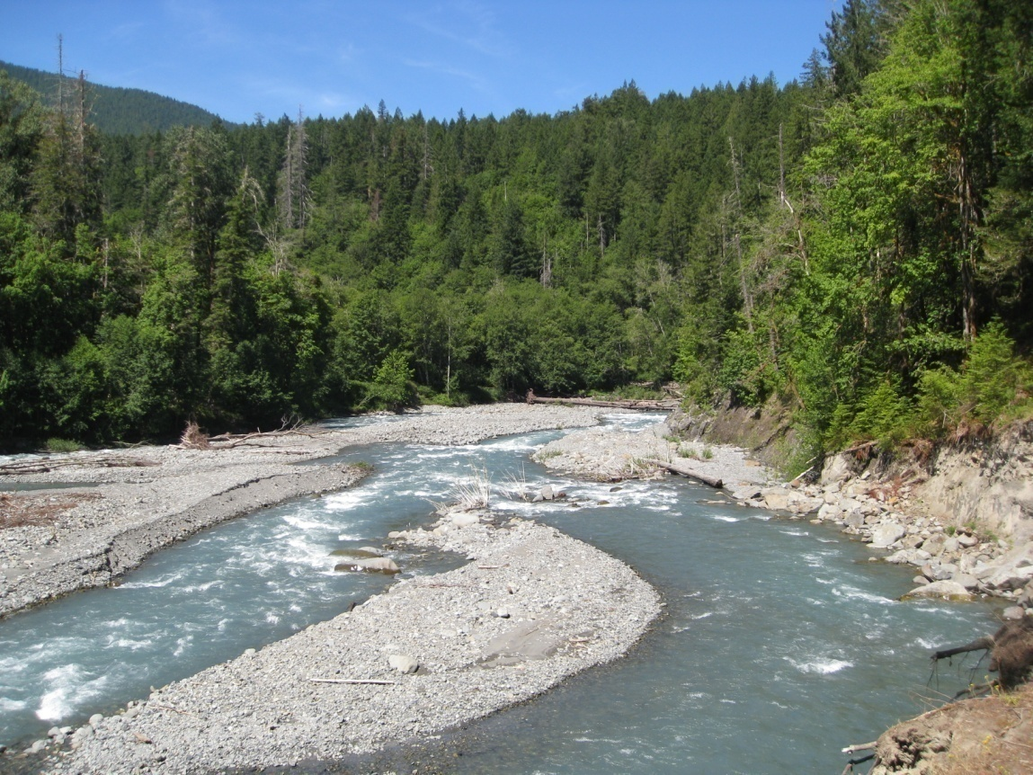
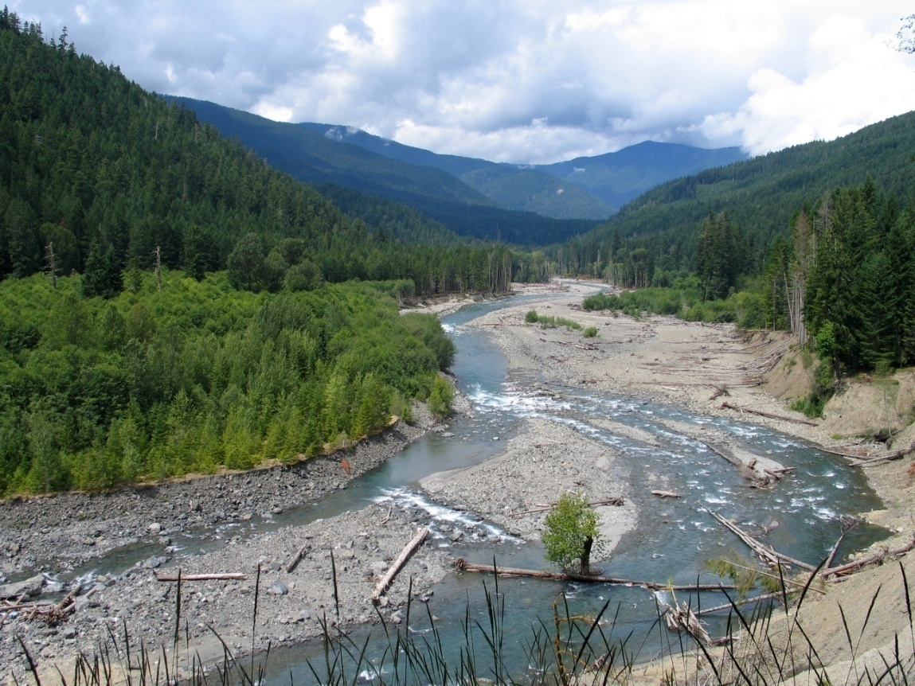
Deposition of Large Materials
Once rivers reach lower gradients, their erosional power decreases and their ability to carry sediment downstream also decreases.
With low flows, rivers deposit larger material, forming cobble banks and gravel bars.
Notes:
These two images of the Elwha river show gravel bars and cobble banks. While these images are taken at relatively low summer flows, during winter floods the waters can cover the entire area that is not vegetated.

Slide 3
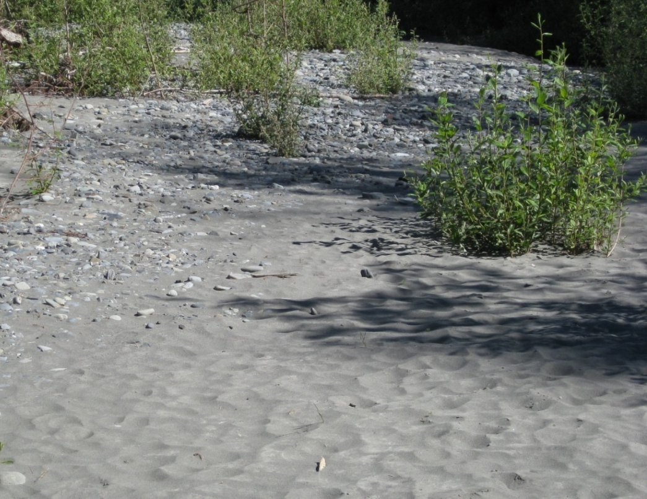
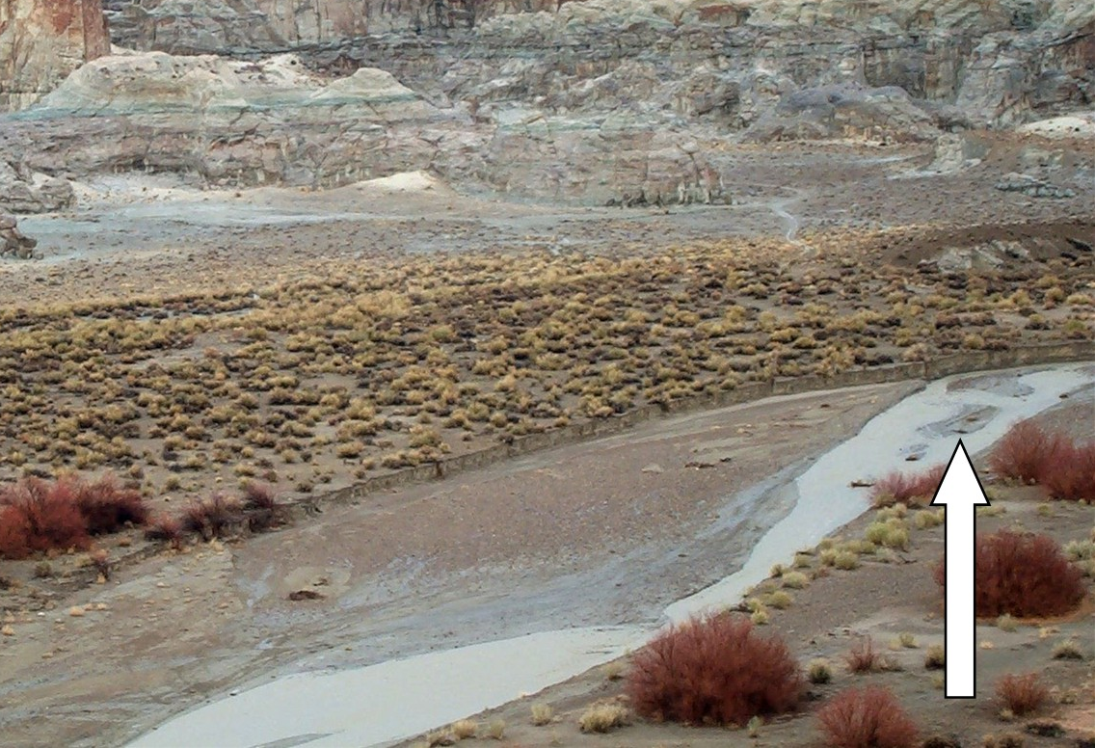
Deposition or pebbles and sand
As the gradient decreases further, the sediment that is deposited gets smaller.
The banks and deeper pools often have layers of sand.
Notes:
The photo at left shows sand and silt deposited along the banks of the Elwha river during a flood event. With the river lower in the summer, these sandy banks are exposed until the next flood.
The image at right shows sand and silt deposited by a slow-flowing stream in Utah. Notice the water is muddy, due to a flash flood event miles upstream bring sediment down.

Slide 4
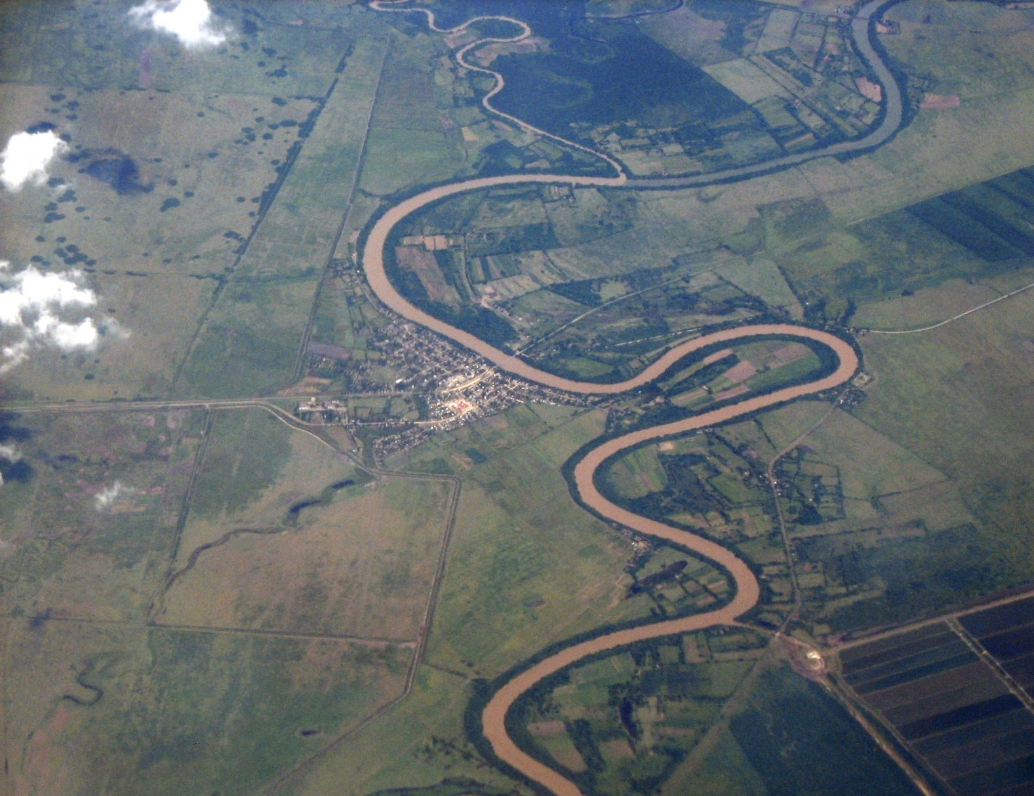
Rivers in Flat Areas Meander
Once gradients are flattened, only sand and silt can be transported and the river begins to meander.
Notes:
Once river gradients reach nearly flat areas, their ability to transport sediment becomes limited to only fine sand and silt that can remain suspended in the water. These rivers begin meandering as they strike sediment mounds and are deflected away. Any further slowing of the river results in even that fine sediment being deposited.

Slide 5
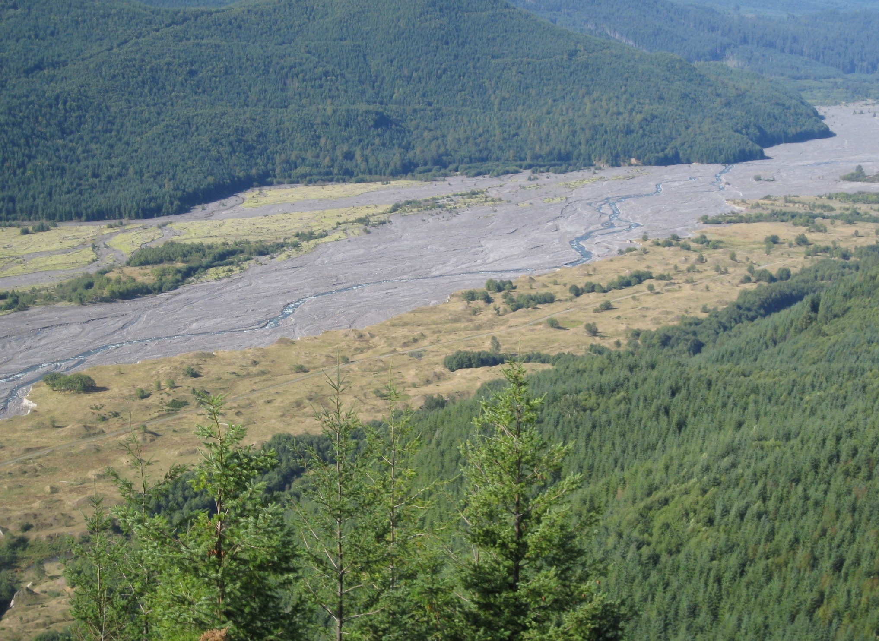
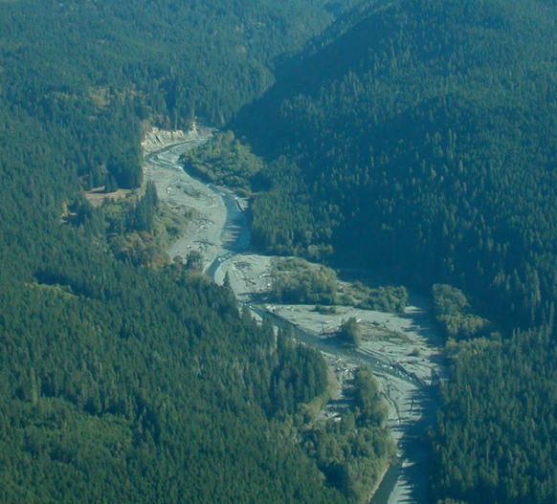
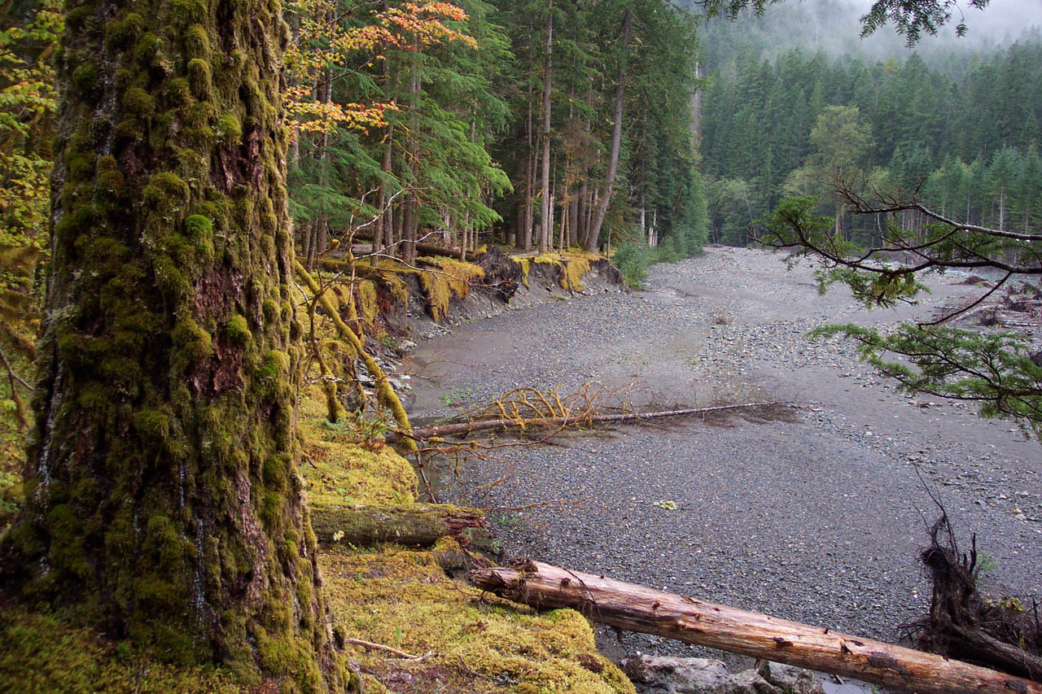
The Flood Plain When Dry
The floodplain is the area available to be occupied by the river as it meanders. It can also be filled completely during floods.
Notes:
The floodplain represents the area available to be occupied by the river. It tends to be bounded by higher topography, such as hills or rock that is difficult to erode. The river, while constrained to the flood plain can meander almost freely across the flood plain or can occupy the entire flood plain during heavy flood events.
The photo at left shows the flood plain of the upper Elwha river. The photo at right shows an area of the Elwha river that has been occupied by the river during higher winter flows, but is dry during the lower summer flow.
The third image that enters is the flood plain of the Toutle river near Mount St. Helens. Almost the entire flood plain was filled with mud up tp 60 feet deep during the 1980 eruption. Today the river meanders across these sediments. The areas above the normal flood plain have stabilized to form grassy terraces.

Slide 6
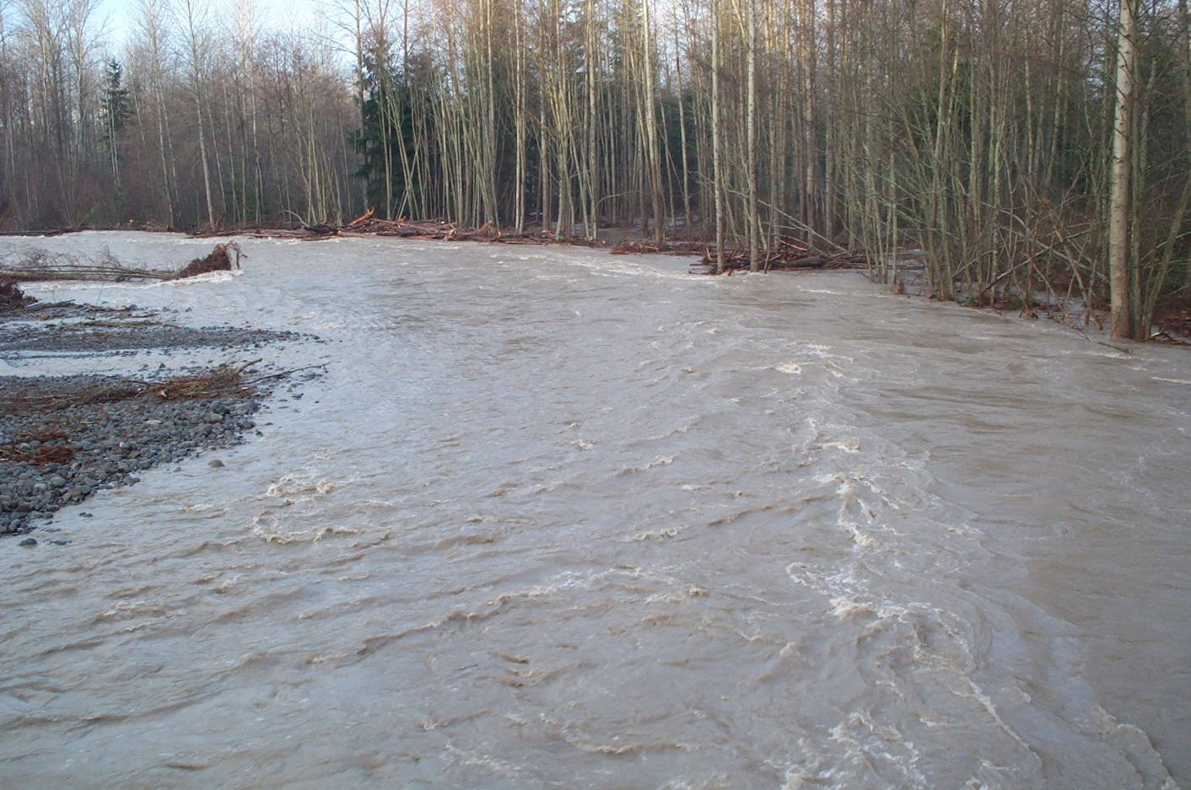
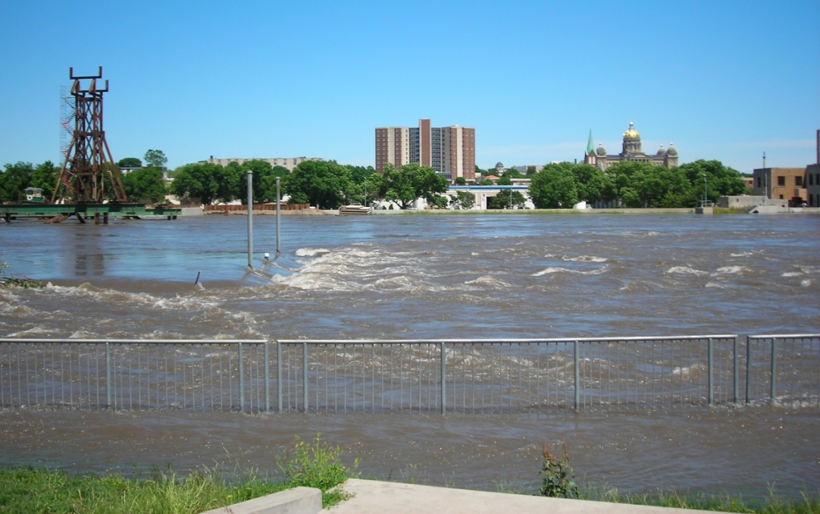
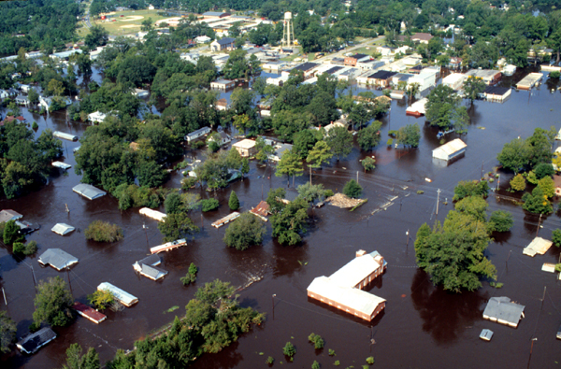
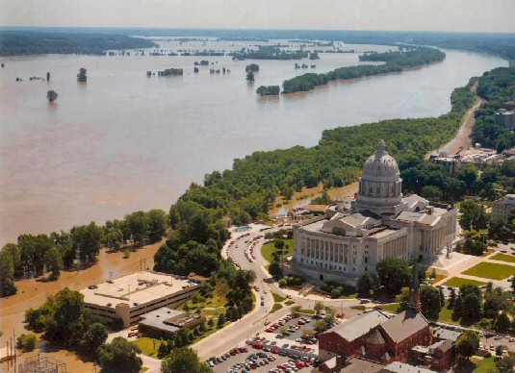
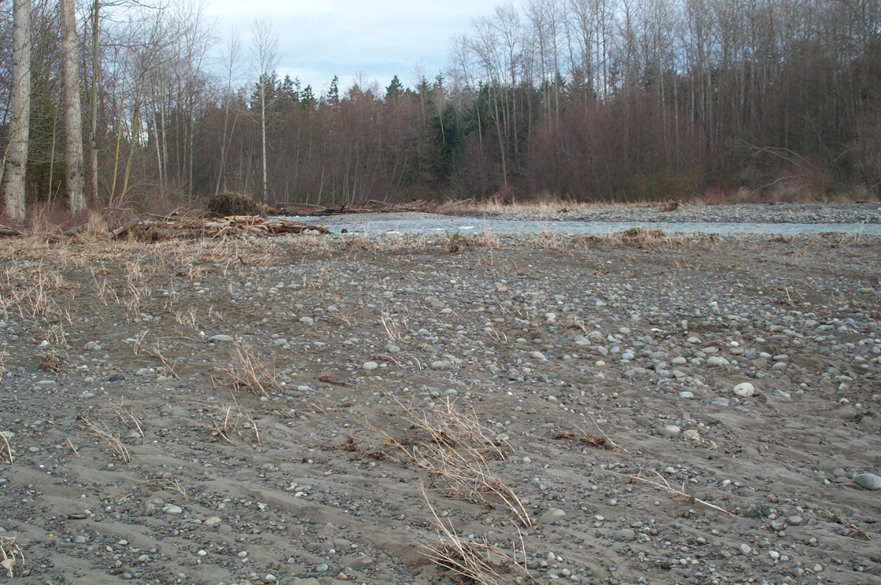
The Floodplain
Notes:
When rivers experience unusually heavy rains, often combined with melting of heavy snow packs in the mountains because of warm temperatures, rivers can surge above their banks to occupy much of the floodplain. While rivers are rising in their banks, their velocity increases and their ability to transport sediment, particularly silt and mud increases dramatically. Once they breach the banks and enter the broad floodplain, the velocity decreases dramatically and much of the sediment is deposited in the surrounding fields and forests.
These sediments are very important for the health of the floodplain ecosystems, because they bring minerals and nutrients to the floodplain for bottomland forests and agricultural activities.
Images clockwise from top-left: The Des Moines River in Iowa rushing through town. A flooded community located within the floodplain. The Mississippi river at St. Louis threatening the capitol building. The after effects of a flood on the Dungeness River, where vegetation on the banks was stripped away, but new sediment was deposited.
Image that fades in: The Dungeness River flooding over its banks and into the riparian forest beyond.

Slide 7
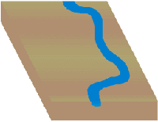
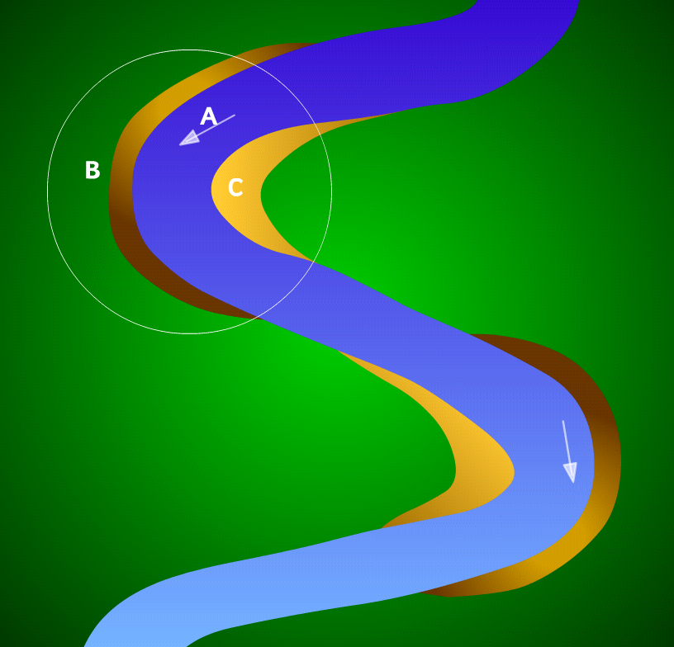
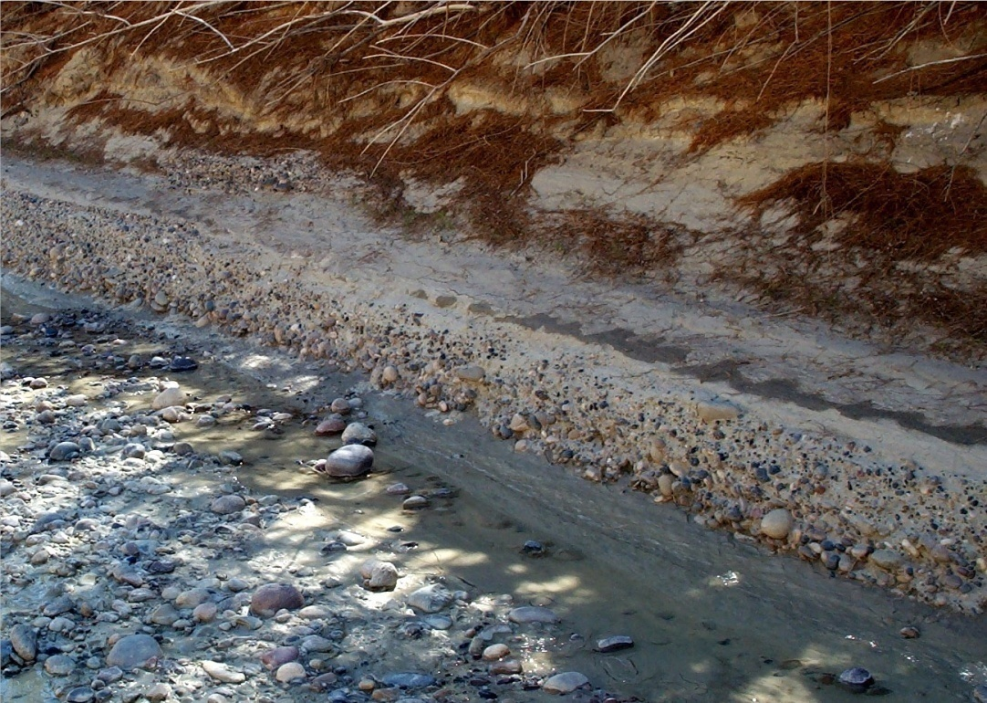
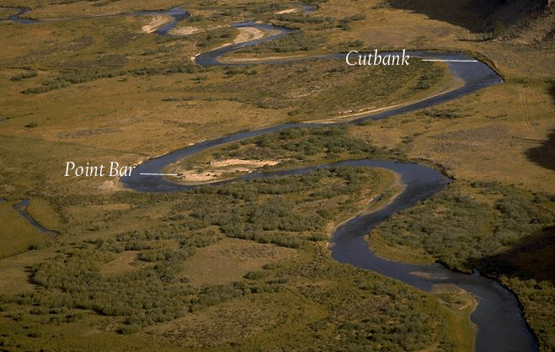
Effects of Meandering Rivers
Notes:
Once rivers hit low gradients and begin to meander, they will constantly change course over time across the entire flood plain. The reason for these changes in course are illustrated above. On the outside turns of the river, the fastest portion of the current hits the banks and erodes into it forming the cut-bank. The lower left image shows a cut-bank on an intermittent stream. On the inside turn, the river is slower and is able to deposit sediments more readily, forming a point-bar, often made of sand and silt.

Slide 8
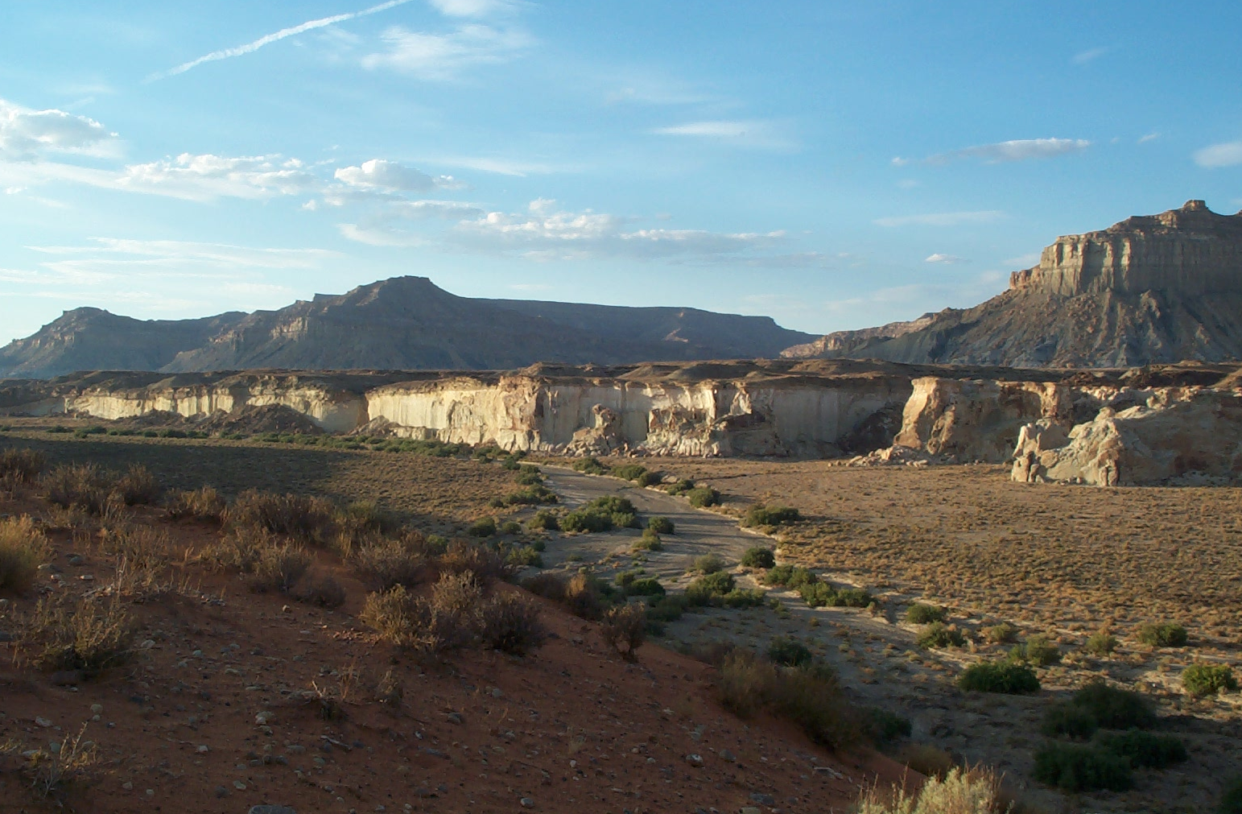
Levees
When sediment accumulates on the side of a river, it can form a barrier that keeps the river within its channel. They tend to build up during flood events.
Floodplain
Levee
Levee
Notes:
Levees can be natural or man-made. Often man will build dirt or concrete walls that constrain the river, so as to control flooding. But, when sediment builds up along the sides of a river course that constrains the river naturally, that is a natural levee.

Slide 9
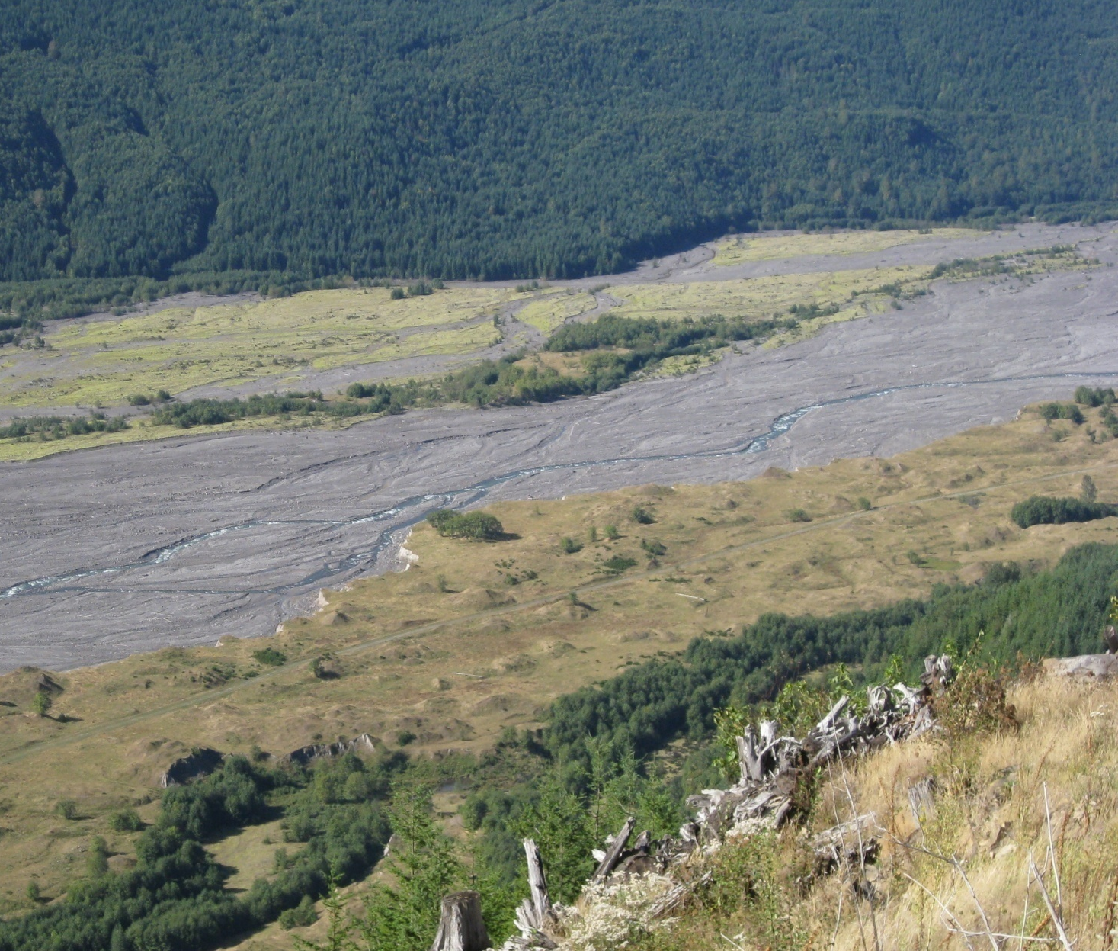
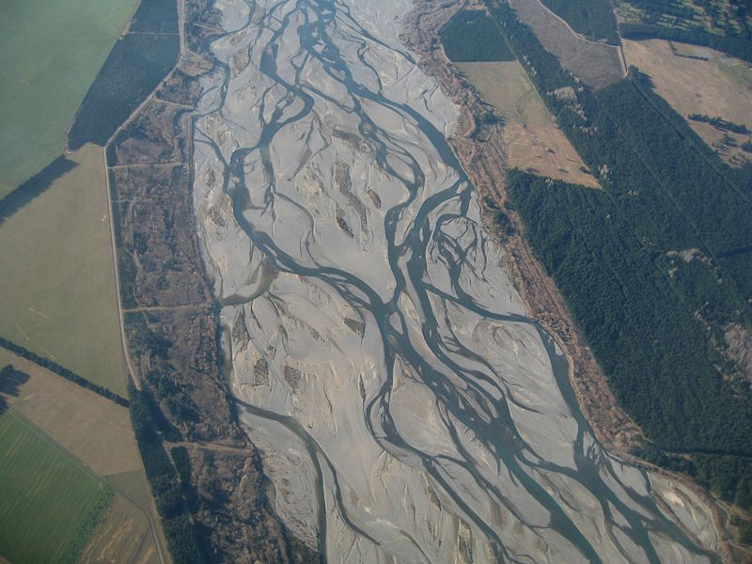
Braided Stream
Notes:
Braided streams form when rivers go quickly from high to low gradients and the floodplain is overloaded with sediments that are deposited when the river’s velocity slows. With so many sediments on the flat valley bottom, the river is constantly eroding into and working its way around sediment bars. This causes it to split into many channels that meander back and forth and reconnect with each other. These types of rivers are most common in glacially-carved valleys in mountainous areas, because glaciers flattened out the formerly V-shaped valleys.
The first image shows the Toutle river valley near Mount St. Helens, where millions of tons of volcanic ash were deposited in the valley during the 1980 eruption. This overloaded the valley with sediment (some 200 feet deep), causes the tiny river to braid back and form across the floodplain.
The second image is a typical glacially-carved mountain valley with a braided stream in New Zealand.

Slide 10
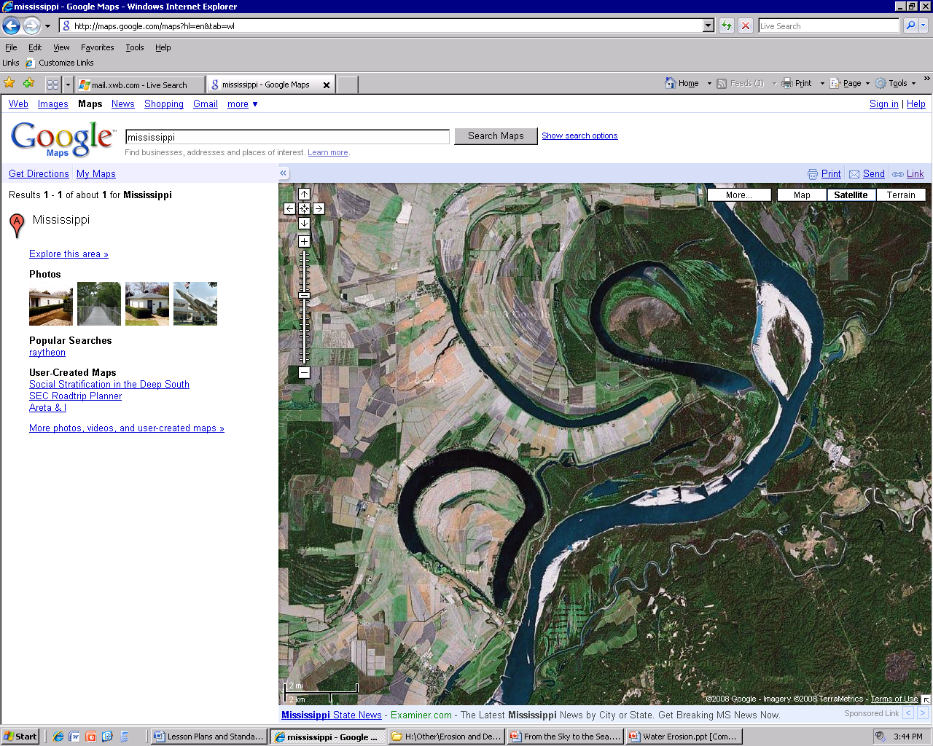
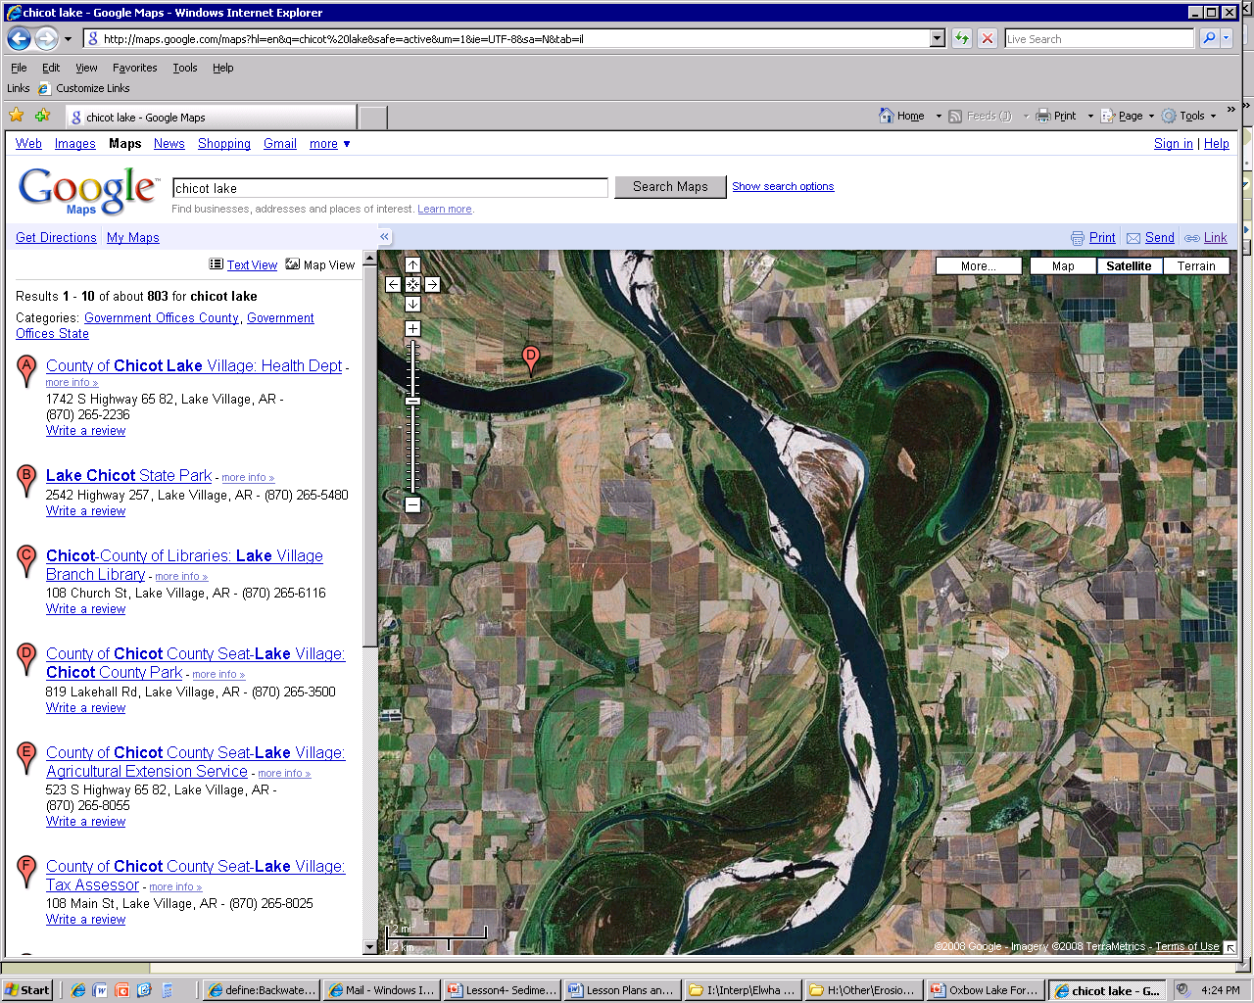
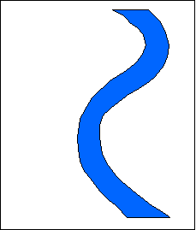
Oxbow Lakes
Notes:
As two meanders approach each other, the river will eventually eat through that gap and straighten its route again. As the river straightens, it will deposit sediment on its slower moving sides, closing the meander. If one portion of the oxbow remains connected to the river, but stagnates and has no flow, it is a backwater. If both portions become completely disconnected, it is an oxbow lake. Eventually oxbow lakes begin to fill due to accumulation of vegetative debris, bank collapses, and sedimentation. However, even when completely filled in, they remain obvious in satellite photos, as seen above.

Slide 11

This project was made possible in part by a grant from
Washington’s National Park Fund.

